Slide 1
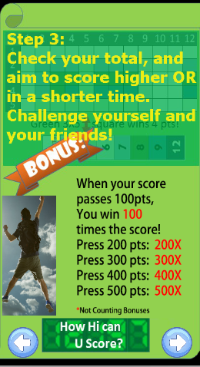
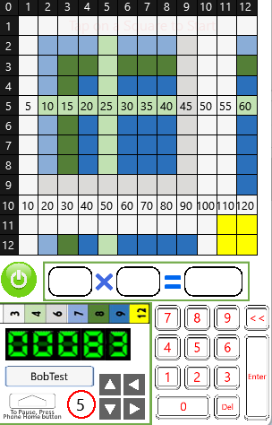
Completion of
Row
Add 12x last score
i.e. Add 12x3 =36.
Press -> Pass
Press -> Pass
Press -> Pass
Previous Score of 80
should become
119 (NOT 83)
> 80+3+(12x3)
> = 80+3+36
> = 119 !
Press -> Pass

Slide 2


Completion of Column
with 144 entry:
Add 12 times last score
= 12x12
Should be 06353
01397
01397 + 12 + (400x12 Bonus)
= 1397 + 12 + 4800
= 6209
01397 + 12 + (400x12 Bonus) + (12x12)
= 1397 + 12 + 4800 + 144
= 6209 + 144
= 6353

Slide 3

Show only at beginning,
Hide after the first tap

Slide 4
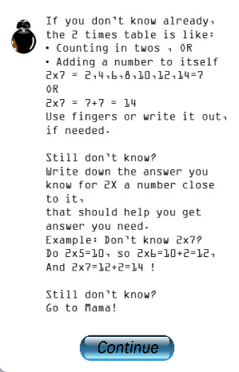
14 = 7
BOLD 14
And delete “=7”
See Error 2TT.png for
Corrected image file

Slide 5

Reduce Green columns
from 5 to 2!
Insert 3,6,9,…21
See Error 3 TT.png
I have also made changes
for Error 4 TT to Error 12 TT
And the new image files are:
Error 4TT to 12 TT.png
There’s no change to
Error 1TT which remains
the same as previous.
3 6 9 12 15 18 21

